Slide 1

Nursing Student Orientation
Infection Control

Slide 2

INFECTION Prevention & CONTROL
A Healthcare Associated Infection (HAI) is an infection that a patient has acquired from their care in a hospital or other clinical setting
CDC estimates 1.7 million Hospital Acquired Infections occur annually in the U.S
99,000 patients die every year from HAI
Evidence shows 15-30% of HAI are preventable

Slide 3
How Do We Prevent Infections?
Through the use of
  Hand Hygiene
  Standard and Transmission based precautions

Slide 4
Hand Hygiene
When should it be preformed?
5 moments of Hand hygiene
before touching a patient,
before clean/aseptic procedures,
after body fluid exposure/risk,
after touching a patient, and
after touching patient surroundings
Hand Hygiene Technique:
Turn on faucet and wet your hands
Apply soap to hands
Rub hands together for approximately 20 seconds
Wash all surfaces of the hands and fingers rinsing hands thoroughly from wrist to fingertips
Dry hands on paper towel and discard towel
Use clean paper towel to turn off faucet
Hand Sanitizer:
Use adequate amount of product to thoroughly cover all surfaces of the hands
Rub until dry before donning gloves - no need to rinse

Slide 5
Hand Hygiene and Nails
Artificial nails, acrylic overlaps, tips, extenders, gels, silk wraps, decorative applications, nail jewelry or any other artificial adherent material are not be worn by staff providing direct patient care or those involved in preparing products for patients
Keep nails less than ¼ inch long

Slide 6
Standard Precautions
A set of infection control practices used to prevent transmission of diseases that can be acquired by contact with blood, body fluids, non-intact skin (including rashes), and mucous membranes that should be used on every patient
Based on the concept that body fluids from ANY patient can be infectious

Slide 7
Transmission based Precautions- Isolation
Based on how specific organisms are transmitted
Contact Precautions
  Anyone entering the room must wear a gown
    Gowns must be properly tied to protect you
  Staff must cover patient with a clean sheet for transport
Droplet Precautions
  Anyone entering the room must wear a surgical mask
  Patient must be transported wearing a surgical mask
Airborne Precautions
  Anyone entering the room must wear an N-95 mask
    Fit testing is required to make sure N95 fits properly
  Patient must be transported wearing a surgical mask

Slide 8
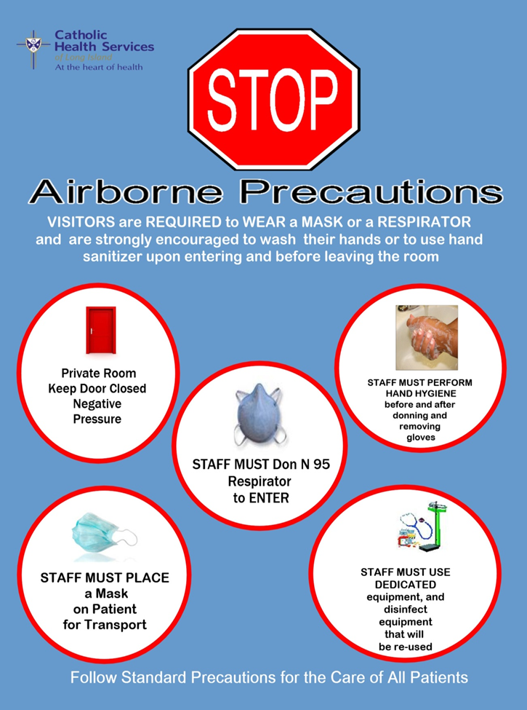
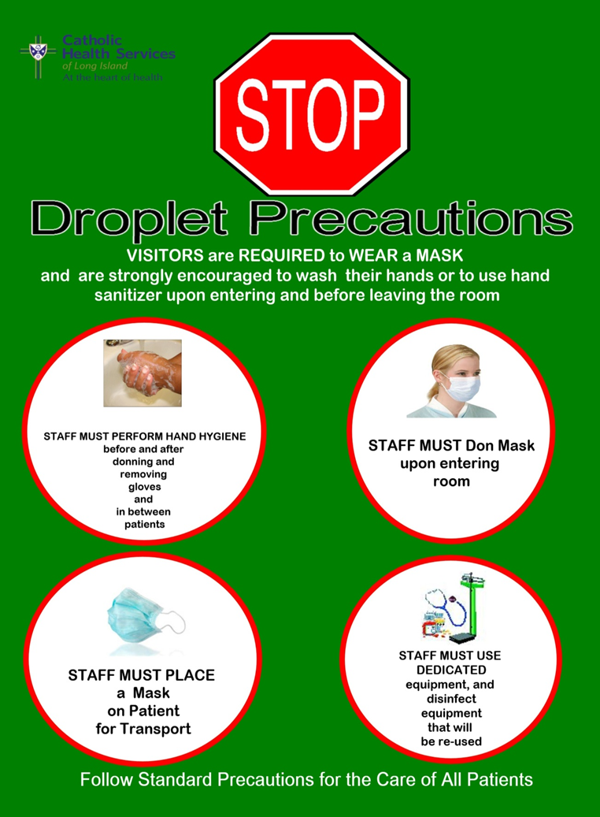
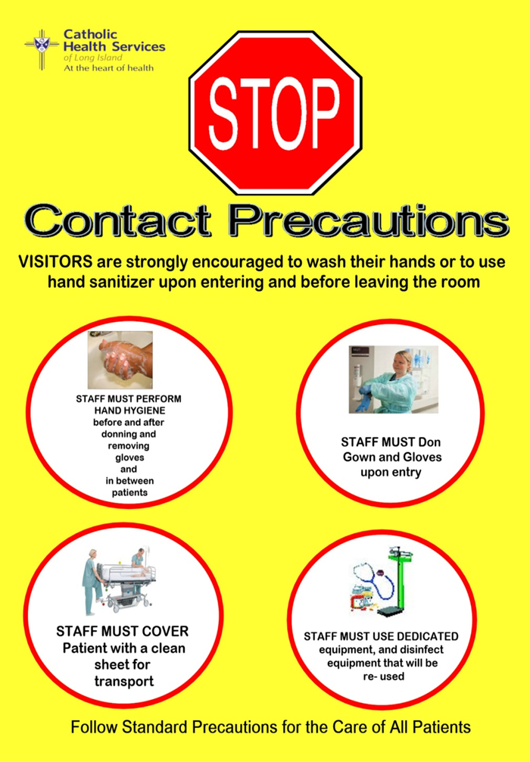
Students will not be entering isolation rooms. If you see this signs posted outside door, please do not go in.

Slide 9
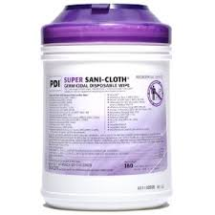
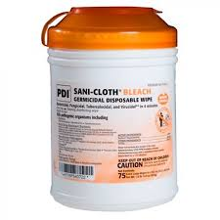
Patient Care Equipment
Equipment that comes in contact with patients must be cleaned after use
Cleaning solutions must have sufficient contact time to be effective
2 minute dry time
4 minute dry time
DO NOT WIPE DRY!

Slide 10

OSHA’s Bloodborne Pathogen Exposure
If you sustain a needle stick injury, experience broken skin or mucous membrane contact with blood or other potentially infectious materials:
          Immediately wash the wound
          Contact your supervisor/Report the incident
          Immediately go to the ER for medical treatment
          Follow up with Employee Health Services

Slide 11
Flu Regulation
NYSDOH regulation requires that all healthcare workers provide documentation that they have been vaccinated against influenza, or have declined to be immunized once flu season is declared by NYSDOH
All employees will be provided with a sticker to place on their ID badges confirming immunization which must be worn and visible while in the hospital
If you opt out of receiving the flu vaccination you will be required to sign a flu declination form AND you will be required to wear a face mask at all times while in patient care areas
Flu masks are available at each entrance of the hospital

Slide 12
Questions
If you have any questions please feel free to reach out to the SJH Infection Control Department, Debbie Kelly, @ 516- 520-2781

Slide 13
Thank You

